Slide 1
MoneyGANs: Generating Synthetic Moneyline Data for Sports Betting Markets
Jake Birnbach
Notes:
I studied the behavior of some popular training optimizers in machine learning

Slide 2
What is a Moneyline Bet?
Captures outcome (winner) of sporting event (i.e., NBA, MLB, NFL, etc.)
Favorite in matchup represented with negative number
-150: bettor must stake $150 to win $100 in profit if favorite wins
Underdog in matchup has positive number
+125: an initial bet of $100 bet yields $125 profit if the underdog wins
Influenced by team performance, injuries, weather conditions, and public betting sentiments.
Adjusts in real time to reflect current state of game
Department of Mathematics and Statistics

Slide 3
Need for Synthetic Moneyline Data
Data Scarcity
Limited availability of accurate sports betting data.
Sportsbooks don’t allow access to proprietary market data
Publicly available data from third parties often expensive and imprecise
Prevents research into key aspects of sports betting markets such as identifying market inefficiencies or testing new betting strategies
Sports betting exploding in popularity due to legalization across U.S. states, need further exploration into market dynamics
Department of Mathematics and Statistics

Slide 4
Applications of Synthetic Data
Researchers can bypass data availability limitations to gain valuable insights into sports betting market dynamics
Can be used to develop and train machine learning models which need large amounts of training data
Beyond sports betting
Can generate realistic patient data to develop sophisticated diagnostic models.
In the autonomous vehicle field, it can create diverse, realistic scenarios for training self-driving vehicles, enabling advancements in areas with limited access to real-world data.
Department of Mathematics and Statistics

Slide 5
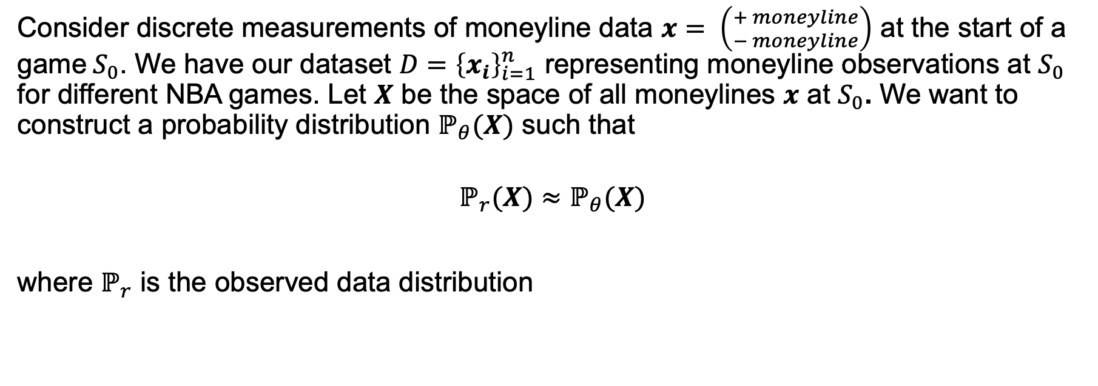
Problem Formulation
Consider discrete measurements of moneyline data $x= \left({+ moneyline \atop − moneyline}\right)$ at the start of a game$S_{0}$. We have our dataset $D={\left\{x_{i}\right\}}_{i=1}^{n}$ representing moneyline observations at $S_{0}$ for different NBA games. Let $X$ be the space of all moneylines $x$ at $S_{0}$. We want to construct a probability distribution $ℙ_{θ}(X)$ such that
$$ℙ_{r}(X)≈ℙ_{θ}(X)$$
where $ℙ_{r}$ is the observed data distribution
Department of Mathematics and Statistics

Slide 6
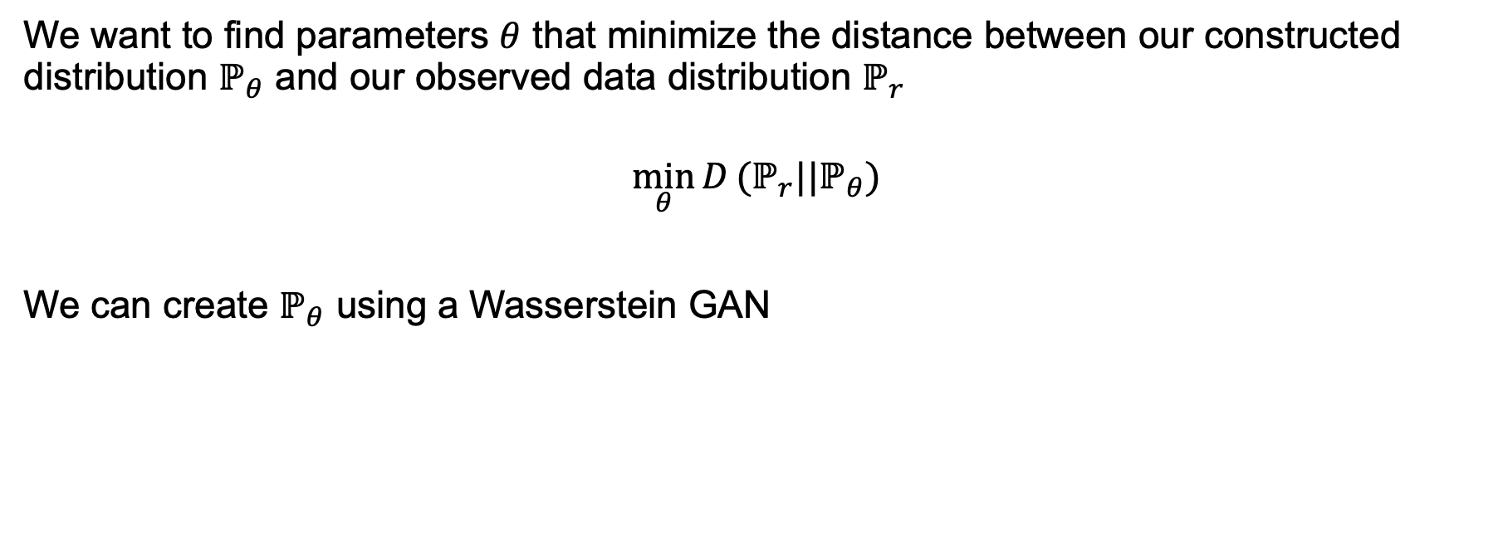
Problem Formulation cont.
We want to find parameters $θ$ that minimize the distance between our constructed distribution $ℙ_{θ}$ and our observed data distribution $ℙ_{r}$
$$\min_{θ}{D}(ℙ_{r}||ℙ_{θ})$$
We can create $ℙ_{θ}$ using a Wasserstein GAN
Department of Mathematics and Statistics

Slide 7
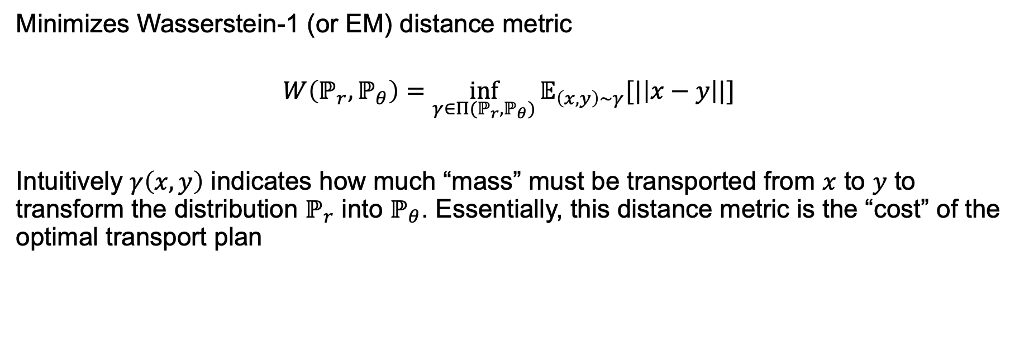
Wasserstein GAN (W-GAN)
Minimizes Wasserstein-1 (or EM) distance metric
$$W\left(ℙ_{r},ℙ_{θ}\right)=\inf_{γ∈Π({ℙ_{r},ℙ}_{θ})}{𝔼_{\left(x,y\right)∼γ}[|\left|x−y\right||]}$$
Intuitively $γ\left(x,y\right)$ indicates how much “mass” must be transported from $x$ to $y$ to transform the distribution $ℙ_{r}$ into $ℙ_{θ}$. Essentially, this distance metric is the “cost” of the optimal transport plan
Department of Mathematics and Statistics

Slide 8
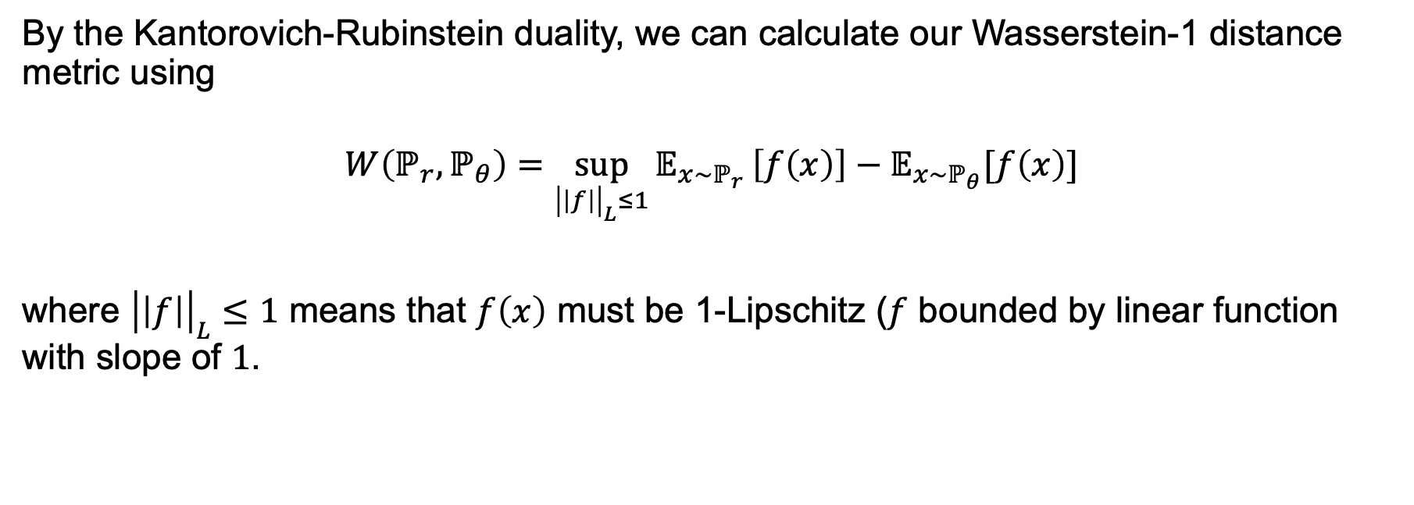
W-GAN cont.
By the Kantorovich-Rubinstein duality, we can calculate our Wasserstein-1 distance metric using
$$W\left(ℙ_{r},ℙ_{θ}\right)=\sup_{{\left|\left|f\right|\right|}_{L}≤1}{𝔼_{x∼ℙ_{r}}}\left[f\left(x\right)\right]−𝔼_{x∼ℙ_{θ}}[f\left(x\right)]$$
where ${\left|\left|f\right|\right|}_{L}≤1$ means that $f\left(x\right)$ must be 1-Lipschitz ($f$ bounded by linear function with slope of $1$.
Department of Mathematics and Statistics

Slide 9
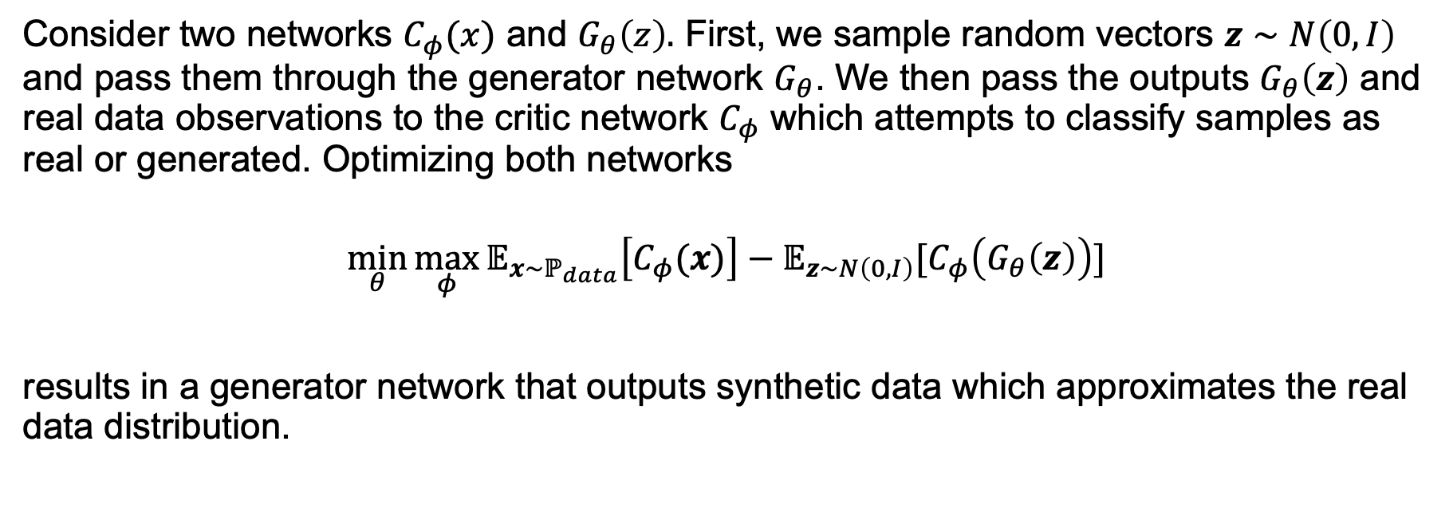
W-GAN Training
Consider two networks $C_{φ}(x)$ and $G_{θ}\left(z\right).$ First, we sample random vectors $z∼N\left(0, I\right)$ and pass them through the generator network $G_{θ}$. We then pass the outputs $G_{θ}\left(z\right)$ and real data observations to the critic network $C_{φ}$ which attempts to classify samples as real or generated. Optimizing both networks
$$\min_{θ}{\max_{φ}{𝔼_{x∼ℙ_{data}}\left[C_{φ}(x)\right]−𝔼_{z∼N\left(0, I\right)}[C_{φ}\left(G_{θ}\left(z\right)\right)]}}$$
results in a generator network that outputs synthetic data which approximates the real data distribution.
Department of Mathematics and Statistics

Slide 10
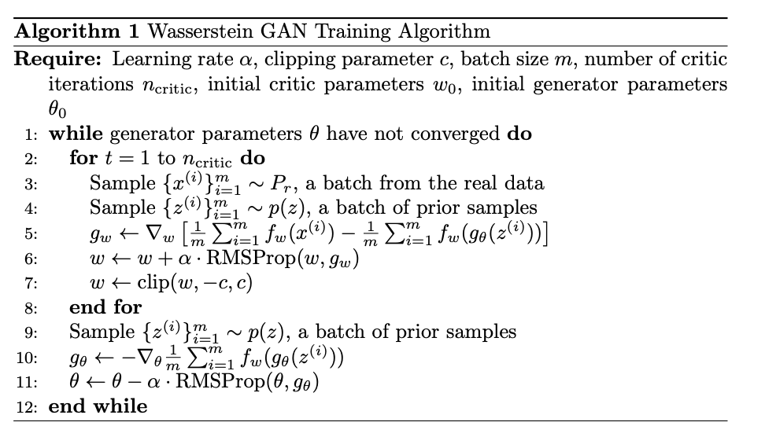
W-GAN Training cont.
Department of Mathematics and Statistics

Slide 11
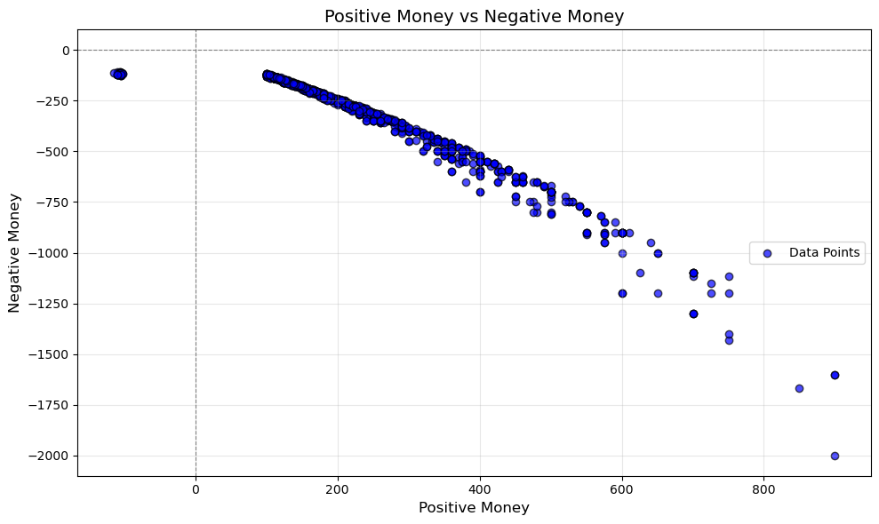
Empirical Data Distribution
Department of Mathematics and Statistics

Slide 12
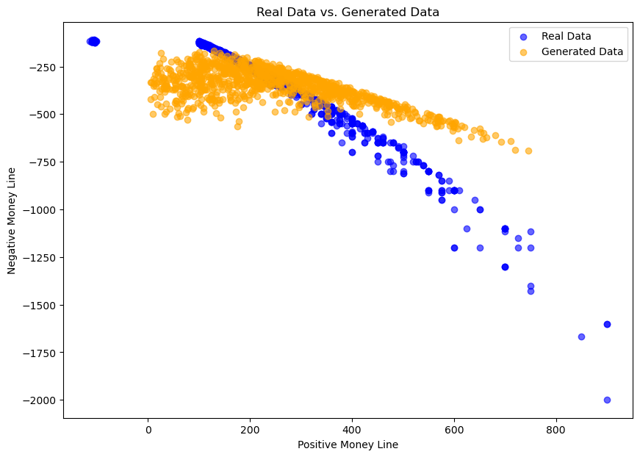
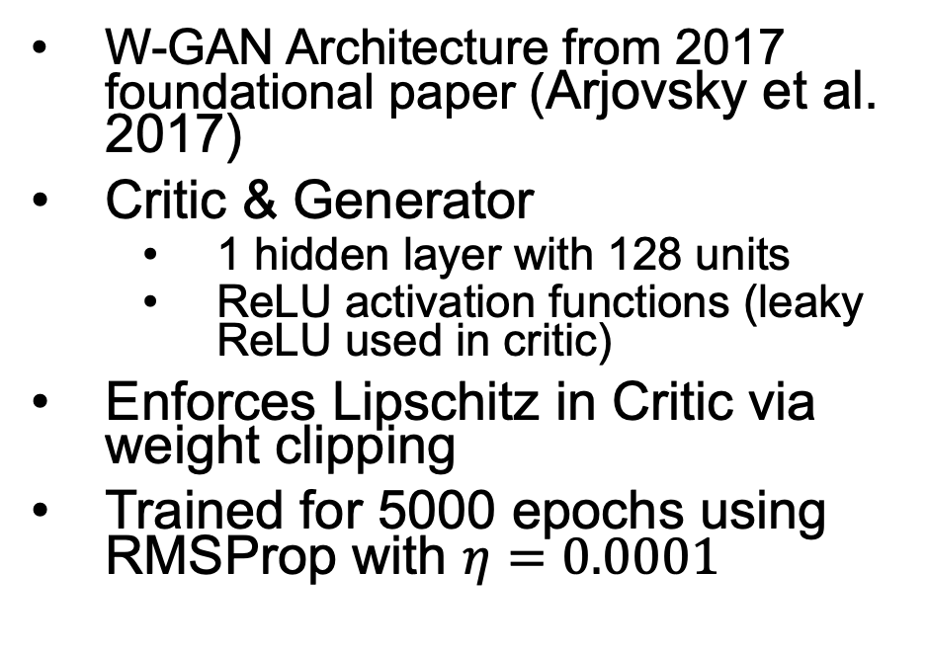
Initial Model
W-GAN Architecture from 2017 foundational paper (Arjovsky et al. 2017)
Critic & Generator
1 hidden layer with 128 units
ReLU activation functions (leaky ReLU used in critic)
Enforces Lipschitz in Critic via weight clipping
Trained for 5000 epochs using RMSProp with $η=0.0001$
Department of Mathematics and Statistics

Slide 13
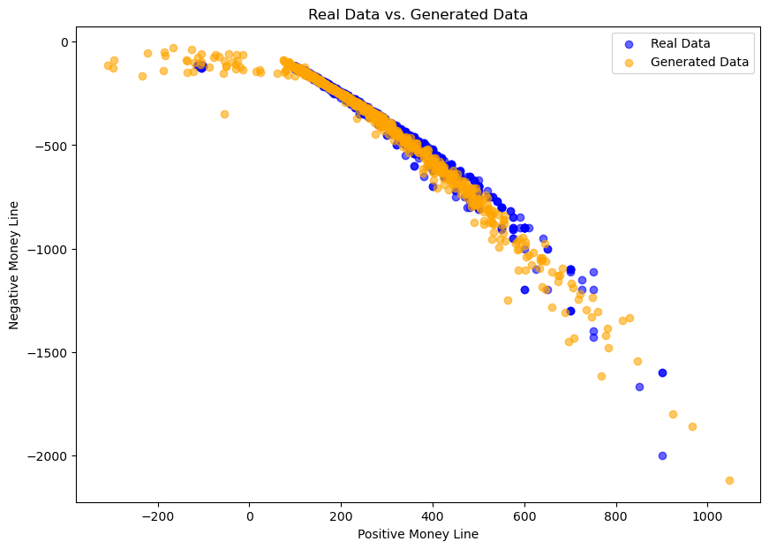
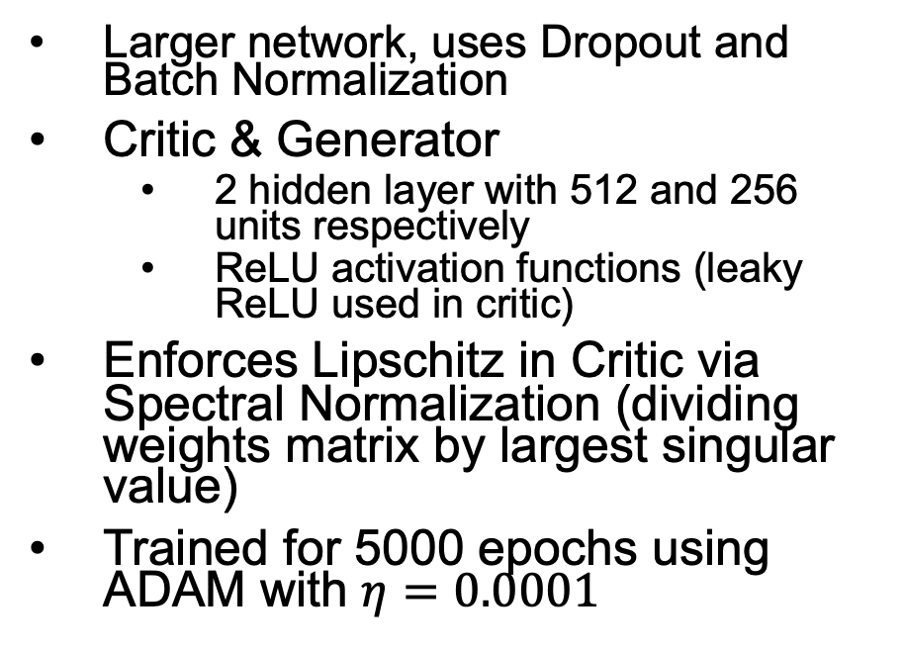
Improved Model with Regularization
Larger network, uses Dropout and Batch Normalization
Critic & Generator
2 hidden layer with 512 and 256 units respectively
ReLU activation functions (leaky ReLU used in critic)
Enforces Lipschitz in Critic via Spectral Normalization (dividing weights matrix by largest singular value)
Trained for 5000 epochs using ADAM with $η=0.0001$
Department of Mathematics and Statistics

Slide 14
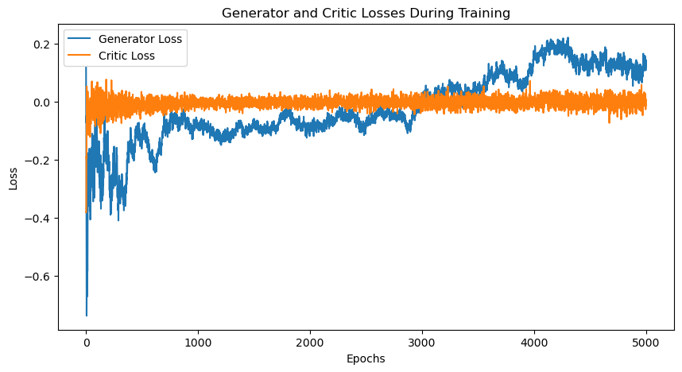
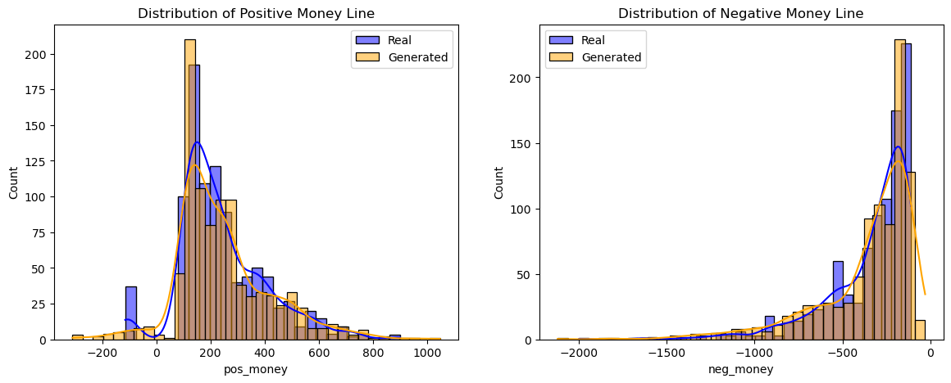
Additional Insights
Appears to be unstable during training
Fails to capture cluster when pos money is negative
Department of Mathematics and Statistics

Slide 15
Future Work
Experiment with larger networks on distributed cluster
Model using traditional mixture modeling
Incorporate Integral Probability Metrics (IPMs) for better training stability
Scale to generate synthetic timeseries data (instead of one point in time)
Department of Mathematics and Statistics

Slide 16


Acknowledgements
Markos Katsoulakis PhD
University of Massachusetts Amherst
Jonathan Larson PhD
University of Massachusetts Amherst
Department of Mathematics and Statistics

Slide 17
References
[1] J. Drape. 2018. Supreme Court Ruling Favors Sports Betting. The
New York Times. Retrieved from https://www.nytimes.com/2018/05/
14/sports/sports-betting-supreme-court.html.
[2] C. Green. 2023. Massachusetts Sports Betting Sites: Best Legal MA Sports-
books. Forbes. Retrieved from https://www.forbes.com/betting/legal/
massachusetts-sports-betting-sites/.
[3] M. Rouse. 2023. Money line bet. Investopedia. Retrieved from
https://www.investopedia.com/money-line-bet-5217219#:~:
text=Money%20line%20bets%20are%20wagers,a%20couple%20of%
20possible%20outcomes.
[4] D. A. Harville. 2023. ”Modern and post-modern portfolio theory as ap-
plied to moneyline betting.” Journal of Quantitative Analysis in Sports,
vol. 19, no. 2, pp. 73-89. De Gruyter. DOI: https://doi.org/10.1515/
jqas-2021-0107.
[5] Forbes Betting Guide. 2023. ”How Sports Betting Odds Work.”
Forbes. Retrieved from https://www.forbes.com/betting/guide/
how-sports-betting-odds-work/#where_do_sports_betting_odds_
come_from_section.
.
6] Levitt, S. D. 2004. Why are Gambling Markets Organised so Differently
from Financial Markets? The Economic Journal, 114(495), 223–246.
https://doi.org/10.1111/j.1468-0297.2004.00207
[7] Goodfellow et al. 2014. Generative Adversarial Networks. arXiv. http:
//arxiv.org/abs/1406.2661.
[8] R. J. Paul and A. P. Weinbach. 2012. Sportsbook behavior in the NCAA
football betting market: Tests of the traditional and Levitt models of
sportsbook behavior. Journal of Prediction Markets
[9] M. Wiese, R. Knobloch, R. Korn, and M. Kretschmer. 2020. Quant GANs:
Deep Generation of Financial Time Series. arXiv. https://doi.org/10.
48550/arXiv.1907.06673
[10] Arjovsky et al. 2017. Wasserstein GAN. arXiv. https://doi.org/10.
48550/arXiv.1701.07875
[11] C. Villani. 2009. Optimal Transport: Old and New. Springer-Verlag Berlin
Heidelberg. DOI: https://doi.org/10.1007/978-3-540-71050-9.
[12] T. Miyato, T. Kataoka, M. Koyama, and Y. Yoshida. 2018. ”Spectral Nor-
malization for Generative Adversarial Networks.” arXiv. Retrieved from
http://arxiv.org/abs/1802.05957. Accessed 6 November 2024
[13] GPT o1-preview. 2024. OpenAi
Department of Mathematics and Statistics

